Slide 1
Customer Analytics
Group Project Overview
March 7, 2019

Slide 2
Agenda
R4DS Ch. 1&2 Quiz
Today’s objectives
Impressive Topics
Group Project Intro
Mike Keenan (TJL)

Slide 3
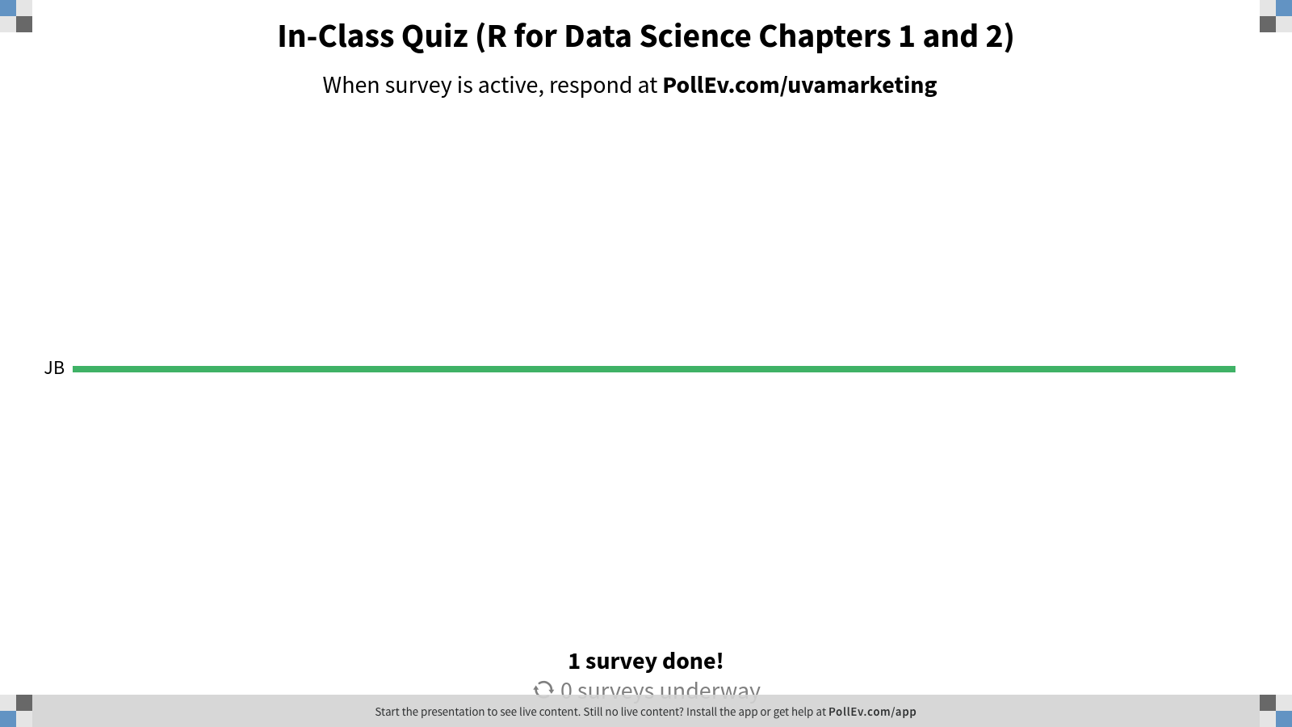
Notes:
In-Class Quiz (R for Data Science Chapters 1 and 2)
https://www.polleverywhere.com/surveys/S5nmpsBlOqKHZnqlTkMfc

Slide 4
Today’s objectives
To learn how you can home in on a topic that is grand, curiosity-inducing, actionable, novel, and broad in scope to give your group project momentum out of the starting gate.
To establish a clear set of goals, requirements, and performance standards (i.e., grading criteria, grading system) for the group project.
Notes:
w/Master - KK

Slide 5
A data scientist is not measured by the cleverness of her solutions, but by the value of the problems she solves.
Elena Grewal, Head of Data Science at Airbnb
https://www.linkedin.com/in/elena-grewal/
Notes:
w/Master - KK

Slide 6
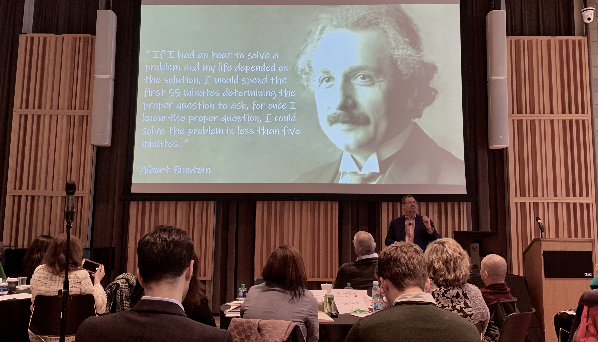
Martyn Crook, VP of Global Knowledge and Insights, Decision Science, Analytics and Data Strategy at The Coca-Cola Company
https://www.linkedin.com/in/martyncrook/
Notes:
https://youtu.be/Ol1FjFR2IMU?t=27775
https://youtu.be/Ol1FjFR2IMU?t=27931
Mine, Hadley, and Jenny’s answers

Slide 7
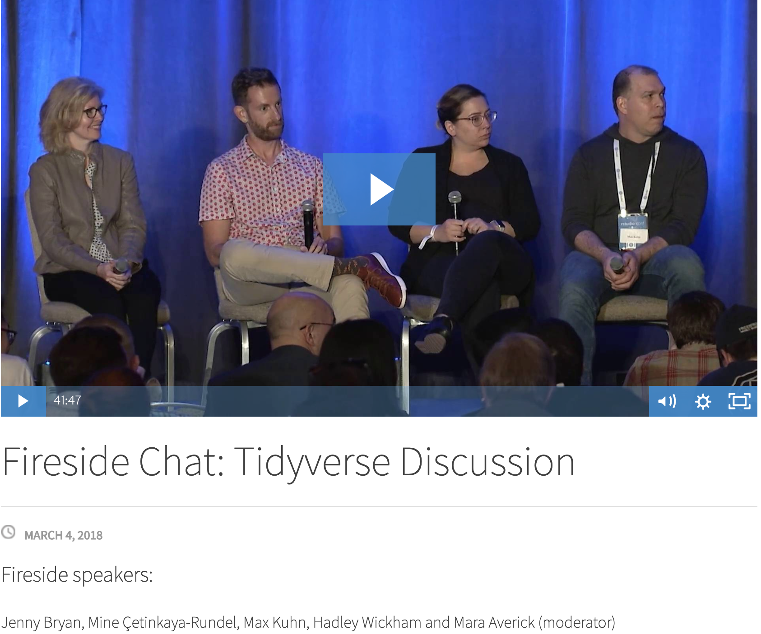
What do you think is most hyped, least important and least hyped, most important in data science?
Tidyverse Discussion at rstudio::conf(2018) in San Diego, CA
https://resources.rstudio.com/rstudio-conf-2018
Notes:
Question from Mara
What's most hyped / least important and least hyped / most important in data science?
https://youtu.be/Ol1FjFR2IMU?t=27779
We’ll hear Mara ask the question and then hear three responses from the panelists.
https://youtu.be/Ol1FjFR2IMU?t=27931
Mine, Hadley, and Jenny’s answers

Slide 8
What can focusing on topics with impressive anatomies do for your projects and your career as a data scientist?
By focusing on topics with impressive anatomies, I will be able to develop interesting insights and make tangible contributions to projects or industry in general. At the same time, it will be enjoyable for me to immerse myself in the process of working on those topics.
- Zhan Zhang
Focusing on topics with impressive anatomies will allow me to leverage my skills to solve critical problems that are of high priority. I will also feel more accomplished working with critical topics and potentially get noticed by managers for doing so.
- Justin Lagomarcino
As a future management consultant, "hard" data science might not play as big of a role in my day-to-day work; however, management consulting is all about choosing the right projects for the right clients. It will help me realize why I am partaking in certain projects and see the bigger picture of why these projects are important to clients (aka they will be broad in scope, actionable, novel, curiosity inducing, and grand)!
- Roy Masha
Discussion Question of the day

Slide 9
How can you increase your chances of focusing on topics with impressive anatomies?
With the help of a value model.
https://nyti.ms/2C558Py

